Slide 1
Undergraduate’s Covariational Reasoning Across Function Representations
Teegan Bailey, University of Florida
Dr. Darryl Chamberlain Jr., Embry-Riddle Aeronautical University – Worldwide
Dr. Konstantina Christodoulopoulou, University of Florida
24th Conference on Research in Undergraduate Mathematics Education
February 26th, 2022

Slide 2
Defining Covariational Reasoning
Covariational reasoning is the mental actions, processes, and constructions used to coordinate two or more varying quantities and interpret the relation between them ¹
Two types of covariational Reasoning
Simultaneous-Independent Reasoning: Coordination of how two independent quantities change with respect to each other²
Example: A ferris wheel and relating the vertical change and horizontal change.
Change-Dependent Reasoning: Coordination of how a quantity changes with respect to change in another quantity²
Example: A ferris wheel and relating the change between time and the vertical change.

Slide 3
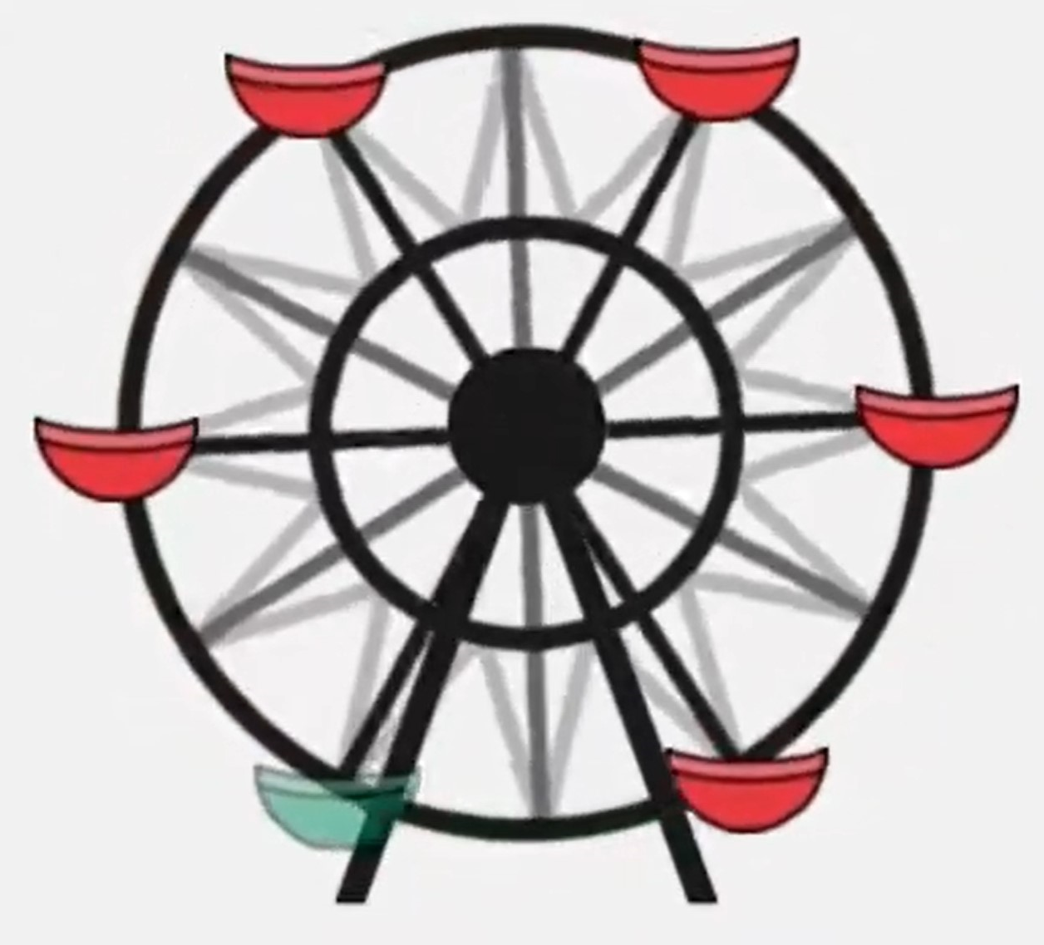
Defining Parametric Functions
Parametric functions are a relation from R to R^{n} where for each unique input, there is a unique n-tuple output²
Example from Taking a ride³
x(t) = cos(t-𝝅/2)
y(t) = sin(t-𝝅/2)
f(t) = (x(t),y(t))
Change-dependent reasoning can be used to understand both x(t) and y(t) since changes in x(t) and y(t) can be coordinated with time (t).
Simultaneous-Independent reasoning can be applied to f(t) because x(t) and y(t) are independent quantities which can be coordinated by their changes with respect to one another.
Taking a ride³

Slide 4
How are students able to use covariational reasoning to create a parametric representation to a real-life 3-dimensional problem?
Research Question:

Slide 5
Theoretical Framework: APOS Theory
Parametric Function
Action
Process
Object
Schema
Participants select major points and construct a specific, point-to-point representation based on this finite collection of points.
Participants are able to act independently from explicit point and construct a continuous representation.
Participants can take representations they have constructed and connect it with other representations to form a dynamic representation
Participants can break down different parts of a representation and understand the relation between each component.

Slide 6
Theoretical Framework: APOS Theory
Parametric Function
 | Action | Process | Object
Definition | Individuals can take a mathematical object and perform an explicit transformation based on external cues. | Individuals can implicitly carry out the transformation and even deviate from the external cues they previously relied on. | Individuals can act on the dynamic, internal procedure as a static object.
Example | Participants can construct a specific, point-to-point representation based on a finite collection of key points. | Participants are able to act independently from the explicit point process and construct a continuous representation. | Participants are able to treat existing representations as static set of functions and transform this set

Slide 7
Study Structure
Instrument
Construct a graph representing each component of the birds location relative to time
Using previous representations, graphically construct a polar parametric representation
Use previous representations to construct a cylindrical representation
60 minute interview

Slide 8
Task 1
Construct a representation between height and time relative to the following point of view

Slide 9
Expected Results: Task 1
Graphing the birds height with respect to time
Action Level Response
Process Level Response
Height
Height
h₁
h₀
t₀
t₁
Time
Time

Slide 10
Task 4
Intermediate tasks asked participants to construct a representation between time and horizontal and vertical position, relative to this point of view
This task challenged participants to combine these representation without referencing time

Slide 11
Expected Results: Task 4
Constructing a graph showing the birds position around the tower (Constructing a polar representation)
Action Level Response
Process Level Response
Time | X | Y
t₀ | x₀ | y₀
t₁ | x₁ | y₁
t₂ | x₂ | y₂
t₃ | x₃ | y₃
t₄ | x₄ | y₄
t₅ | x₅ | y₅
t₂
t₁
t₀
t₃
t₄
t₅

Slide 12
Expected Results
The tasks can be classified based on whether we would expect students to apply change-dependent reasoning or simultaneous-independent reasoning order to be successful
Task 1
Focusing on analyzing students abilities with change-dependent reasoning
Graphing positional components with respect to time
Task 4
Prompting students to transition to simultaneously independent reasoning
Graphing positional components with time being implicitly represented

Slide 13
Results Overview
The student, pseudonym Jane, possessed an action level understanding of covariational reasoning which was identified through:
Task 1
Constructing a measurement system to mark determine points
Utilizing these points to create a “chunky” representation
Task 4
Took points from prior representations and used time as a key to explicitly correlate with other representations
Took “snapshots” at these key times to develop a “chunky” representation
Their personal definition of a function and derivative during the interview

Slide 14
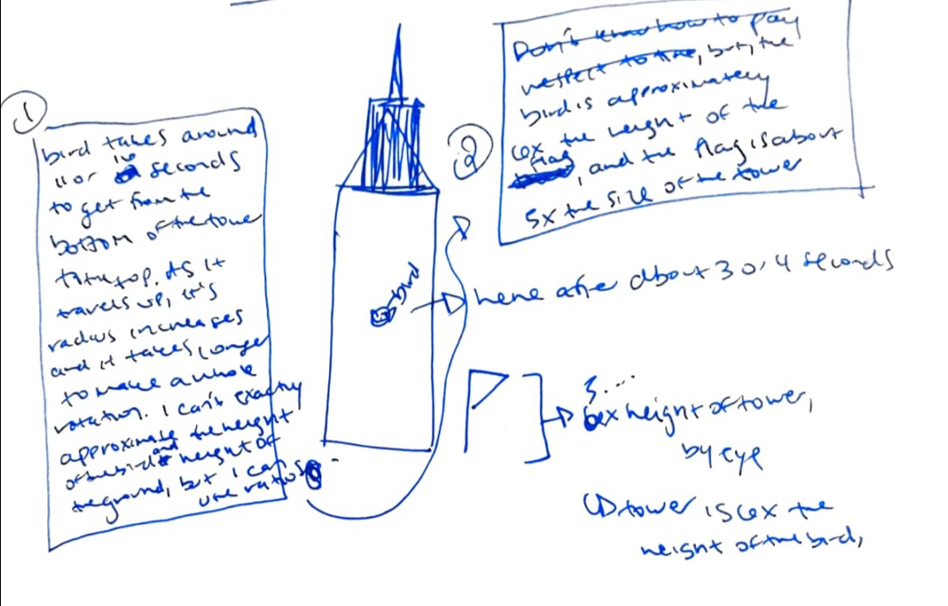
Task 1 Results
Graph the birds height with respect to time
Bird is approximately 6x the height of the flag… flag is about 5x the size of the tower
Bird takes 11 or 16 seconds to get from bottom of the tower to the top
5x height of tower…
Tower 156x the height of the bird

Slide 15
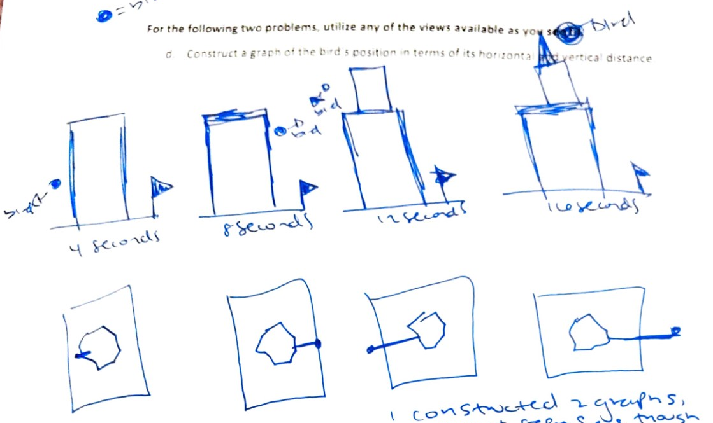
Task 4 Results
Construct a graph showing the birds position around the tower (Constructing a polar representation)
Constructed 2 graphs… feels as though height and horizontal distance grow at a rate of 2

Slide 16
Exploring Student’s Schema of Parametric Functions
Function
Derivative
“A function is a formula with variables and numbers and coefficients that you plug in independent data you are observing”
“Derivatives are rates of change that can sometimes be a function that pay respect to time”

Slide 17
Conclusions
Student was unable to coordinate the change in two quantities with respect to each other.
Student could not internalize and control the point construction process and was reliant on finding external key points to construct their representation.
Student was unable to coordinate the the change in three quantities.
Their action conception of function hindered them when trying to coordinate multiple quantities.
When asked to apply simultaneous independent reasoning, they relied on time to interpret the relationship between quantities.
Taking a ride³

Slide 18
Implications
Covariational reasoning may need to be explicitly taught to better prepare students for higher level courses
Awareness of two ways to reason covariationally (Simultaneous Independent vs Change Dependent)
Encouraging students to step away from chunky reasoning
Stepping away from specific values
Students may be unable to separate their definition of the derivative from being with respect to time
Deemphasizing time as a variable in derivatives
Time cannot be removed but we can choose to not pay attention
Ex. how volume of a cone changes with respect to the radius
Notes:
Talking about the derivative from a quantity representation; how they change with respect to each other
Creating questions with various quantities and prompting students to define the relationship between them
Confront time directly (time is there, we just are not paying attention)
Mentioning the change-dependent reasoning and independent reasoning

Slide 19
Future Work
Expansion of the number of participants
As a pilot study, this work focused on a single student. Our results were consistent with prior studies and showed the instrument was able to yield results
Future work could not only include more participants, but also include students with different conceptions for function and derivative
Expansion of functions used
This study was constructed to be used with first semester calculus students and as such the functions that were used were linear and trigonometric
Future work may focus on other function representations and how students identify those functions and reason with them
Notes:
Talking about the derivative from a quantity representation; how they change with respect to each other
Creating questions with various quantities and prompting students to define the relationship between them
Confront time directly (time is there, we just are not paying attention)
Mentioning the change-dependent reasoning and independent reasoning

Slide 20
References
Carlson, M., Jacobs, S., Coe, E., Larsen, S., & Hsu, E. (2002). Applying Covariational Reasoning While Model Dynamic Events: A Framework and a Study. Journal For Research in Mathematics Education, 352-378.
Stalvey, H. E., & Vidakovic, D. (2015). Students' Reasoning about relationships between variables in a real-world problem. The Journal of Mathematical Behaviour, 192-210.
Stevens, I. E., & Moore, K. C. (2016). The Ferris wheel and justifications of curvature. In M. B. Wood, E. E. Turner, M. Civil, & J. A. Eli (Eds.), Proceedings of the 38th annual meeting of the North American Chapter of the International Group for the Psychology of Mathematics Education (pp. 644-651). Tucson, AZ: The University of Arizona.

Slide 21
Extended Instrument Demo

